Slide 1

O-Group APP
Joshua Paterson - B.Eng (Computer and Software Systems)

Slide 2
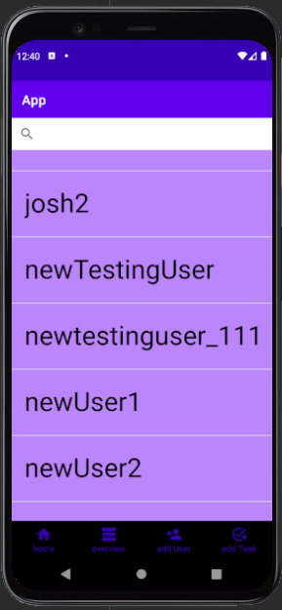
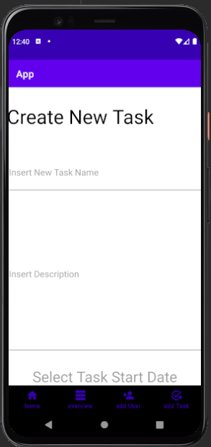
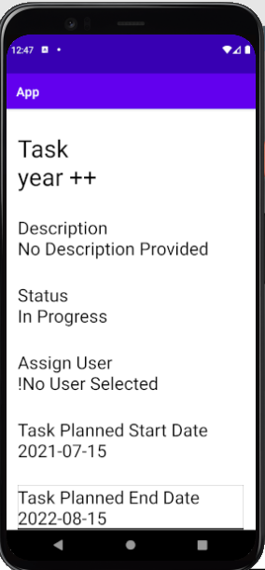
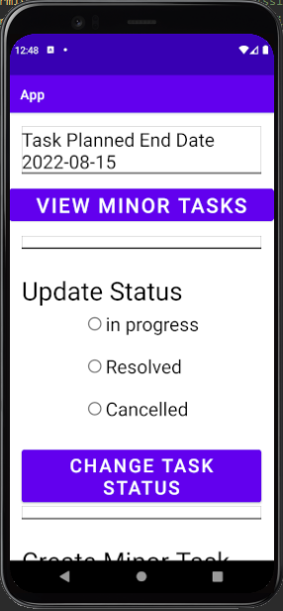
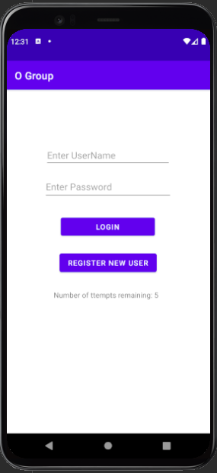
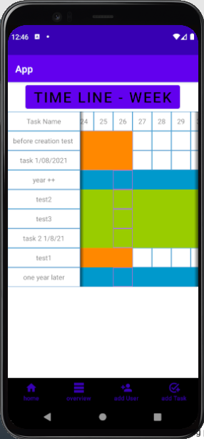
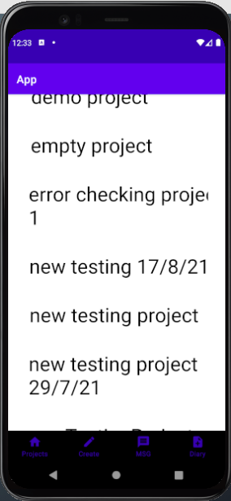
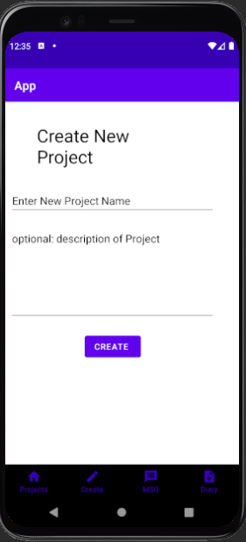
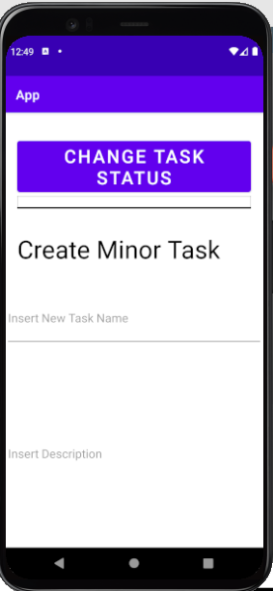
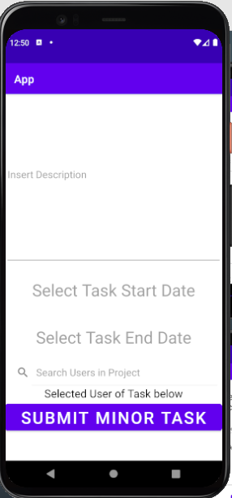
What is O Group

Slide 3
Security
Why a Custom Solution
Australian Government Information Security Manual – Australian Signals Directorate
Key exchange method
Constraints
iOS kill codes
Web app

Slide 4
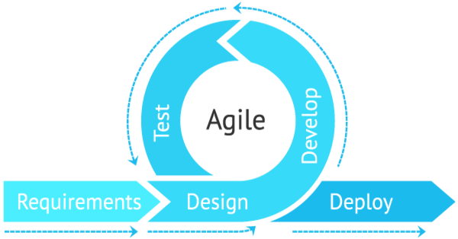
Capability
Iterative development

Slide 5
Recap of design decisions
Java application
AES-256 for general encryption
RSA-3072 for key exchange
SHA-2-384 with salt for one way data encryption
Capability choices will likely be a continually evolving/iterating process

Slide 6
Application in its current state
Structure and networking implemented
Encryption algorithms implemented
Some basic functionality

Slide 7
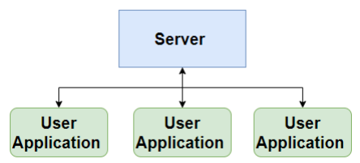
architecture of the app
Overarching approach
Object-oriented programming (OOP) – programming model
Agile Development Methodology
High level Data Flow Overview

Slide 8
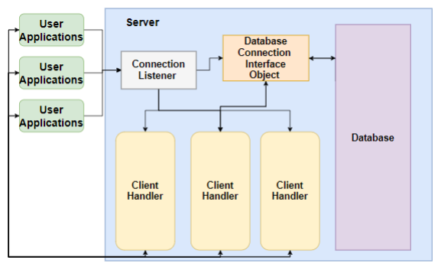
Server

Slide 9
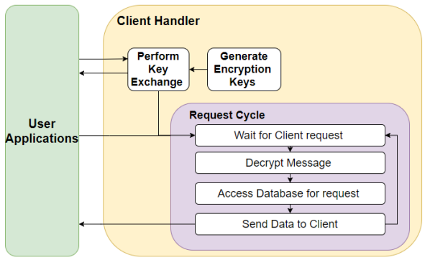

Slide 10
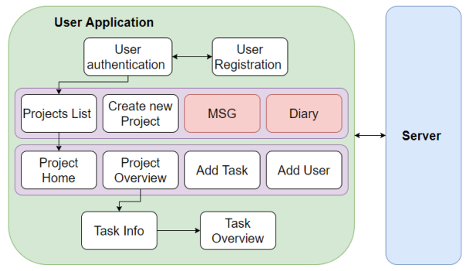
User applications

Slide 11
Future works
Further Capability Development
Deployment
UX testing

Slide 12
Questions

